Slide 1


Design Thinking for Innovation 1

Slide 2
Agile Leadership
Our Motto -
“Delivering Value through People,Passionate learning and Innovation”

Slide 3
01
This course explores Design Thinking for Innovation.​
Course Overview
02
The core objective of this course to expose decadevs to the importance of design thinking for innovation and problem solving.
Course Objective
03
Upon completion of this course, decadevs are expected to:
To understand design thinking and when to use it
Know how to site pain points of customers and provide a working solution to it.
Understand innovation management tools and the risks of innovation
Learning Outcome
04
Workshop/Discussion method
Teaching Approach
05
The assessment for this course is attached to the last slide of this deck.
Assessment

Slide 4

DESIGN THINKING
Design thinking is an iterative method that helps resolve user issues or redefines problems in alternative strategies and solutions, the overall goal is to identify alternative strategies and solutions that are not instantly apparent with your initial level of understanding.
Design thinking is more than just a process; it opens an entirely new way to think, and it offers a collection of hands-on methods to help you apply this new mindset.

Slide 5
IMPORTANCE OF DESIGN THINKING
Human centric : It seeks to deeply understand users' needs, behaviors and experiences to create effective solutions catering to their unique challenges and desires.
Iterative process: It allows for continuous improvement. Solutions are refined through prototyping and testing, reducing the risk of failure and saving time and resources in the long run.
Redefines problems: It emphasizes properly defining the problem, which is often as important as finding the solution. This helps avoid "solution bias" and ensures efforts are directed toward the right problem.
Empathy: Design thinking begins with empathy, where designers seek to understand the perspectives, emotions, and pain points of the people they are designing for.
Solution based approach: The emphasis of design thinking is on the desired outcome rather than the problems. Using a design thinking process, we can solve more complicated problems that require a bit more depth of knowledge and data.

Slide 6
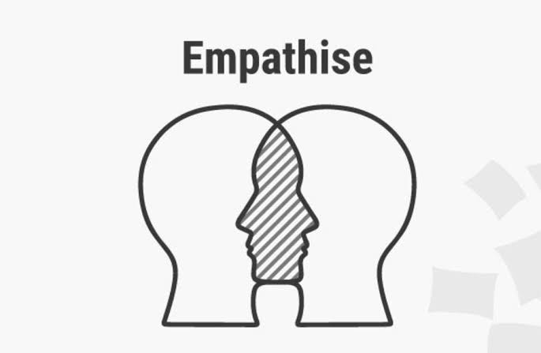
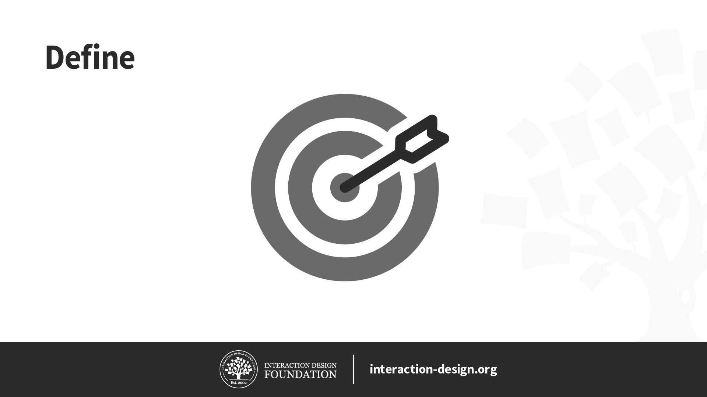
PROCESS OF DESIGN THINKING
Empathize: The Design Thinking process starts with empathy. To create desirable products and services, you need to understand who your users are and what they need. What are their expectations about the product you’re designing? What challenges and pain points do they face within this context? Empathizing with the users helps you to get a better understanding of the problem.
Define: in this stage you’ll gather all of your findings from the empathize phase and start piecing them together. What common themes and patterns did you observe? What user needs and challenges consistently came up? This makes you identify the exact problem you should work on.

Slide 7
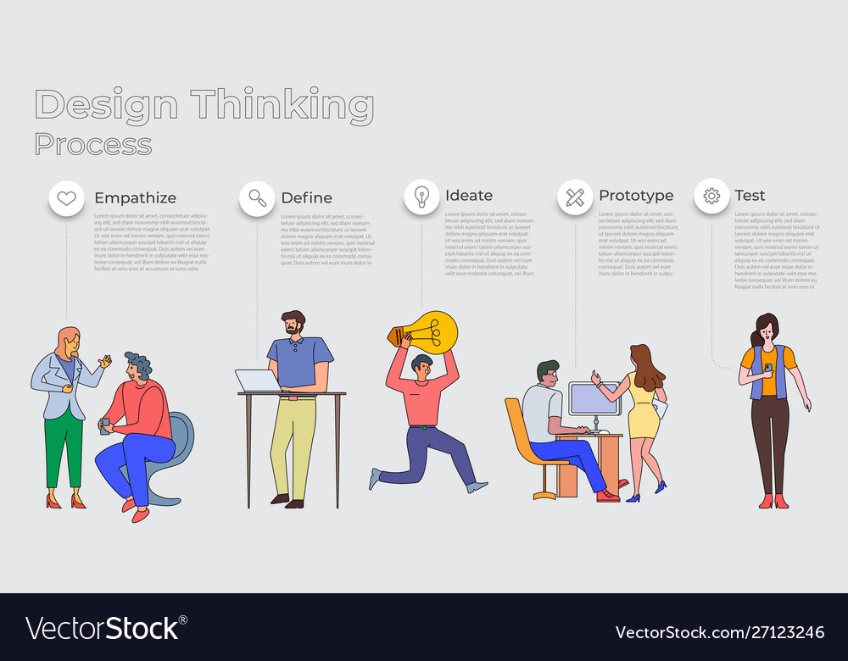
PROCESS OF DESIGN THINKING
Ideate: This stage is to strategize solutions to the problem, you’ll continuously refer back to your problem statement. As you prepare to move on to the next phase, you’ll narrow it down to a few ideas that can be tested.
Prototype: The aim of the prototyping stage is to turn your ideas into something tangible which can be tested on real users. Create a design of the solution that you have gotten in the ideate phase.
Test: Test the design solution. The results of the testing phase will often require you to revisit the empathize stage or run through a few more ideation sessions before you create that winning prototype.

Slide 8
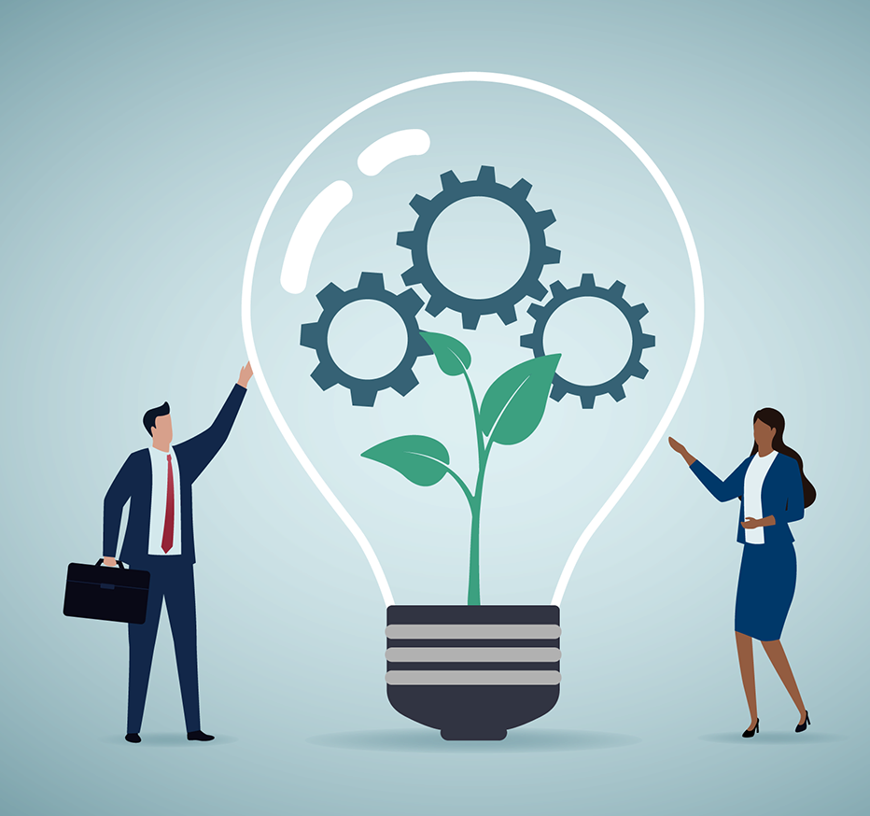
Innovation Process
The innovation process is translating new or existing knowledge into marketable products, solutions, or services.
This is an important step for businesses because it is an opportunity to strategize, introduce new concepts, and business models.

Slide 9
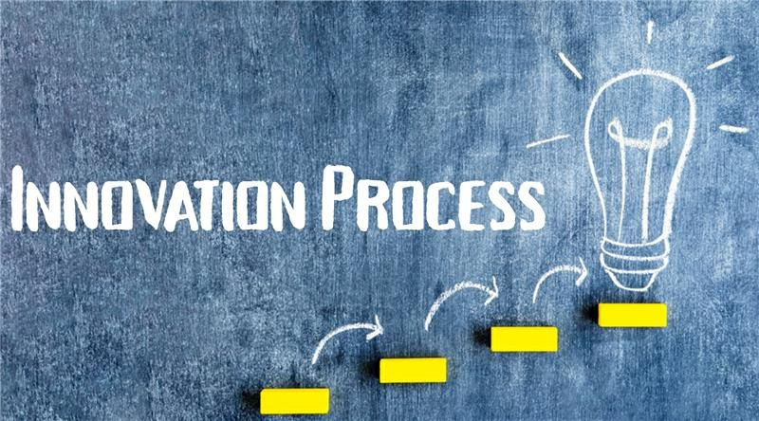
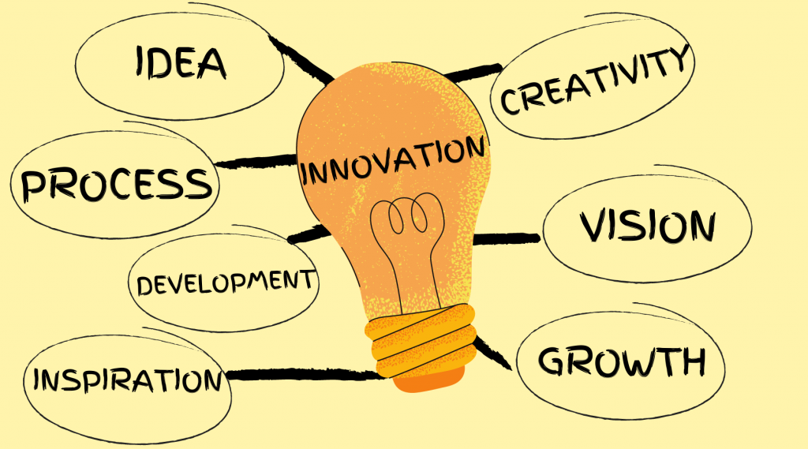
The Innovation Process
Innovative idea generation
Brainstorming creative ideas by using idea generation techniques such as creativity techniques and design thinking.
2. Concept(Advocacy, screening and experimentation
Gathering information to help evaluate the feasibility of a business idea and to understand the customer’s needs.
3. Solution
A ready-to-use solution is developed and brought to the market.
4. Commercialization and marketing
This step develops market value for an idea, product, or service by focusing on its impact and bringing the product to potential customers.
5. Diffusion and Implementation
The spread and acceptance of the idea/product.

Slide 10
Innovation Management Process
Push vs. Pull
Push strategy involves actively pushing products or services to customers through advertising and promotions, while pull strategy focuses on creating demand by attracting customers toward the product or service.
Lean Start- Up
This is a way for you to use a feedback loop to test your business idea by reducing waste and optimizing resource allocation. The lean startup method advocates developing products that consumers have already demonstrated they desire so that a market will already exist as soon as the product is launched. As opposed to developing a product and then hoping that demand will emerge.

Slide 11
Innovation Management Process
Phase Gate
The phase gate process is a technique that is used to guide a project from conception to launch. It requires a review of each project stage before moving on to the next. In the phase gate review process, specific criteria must be met to determine the success of a phase and the ongoing viability of a project.

Slide 12
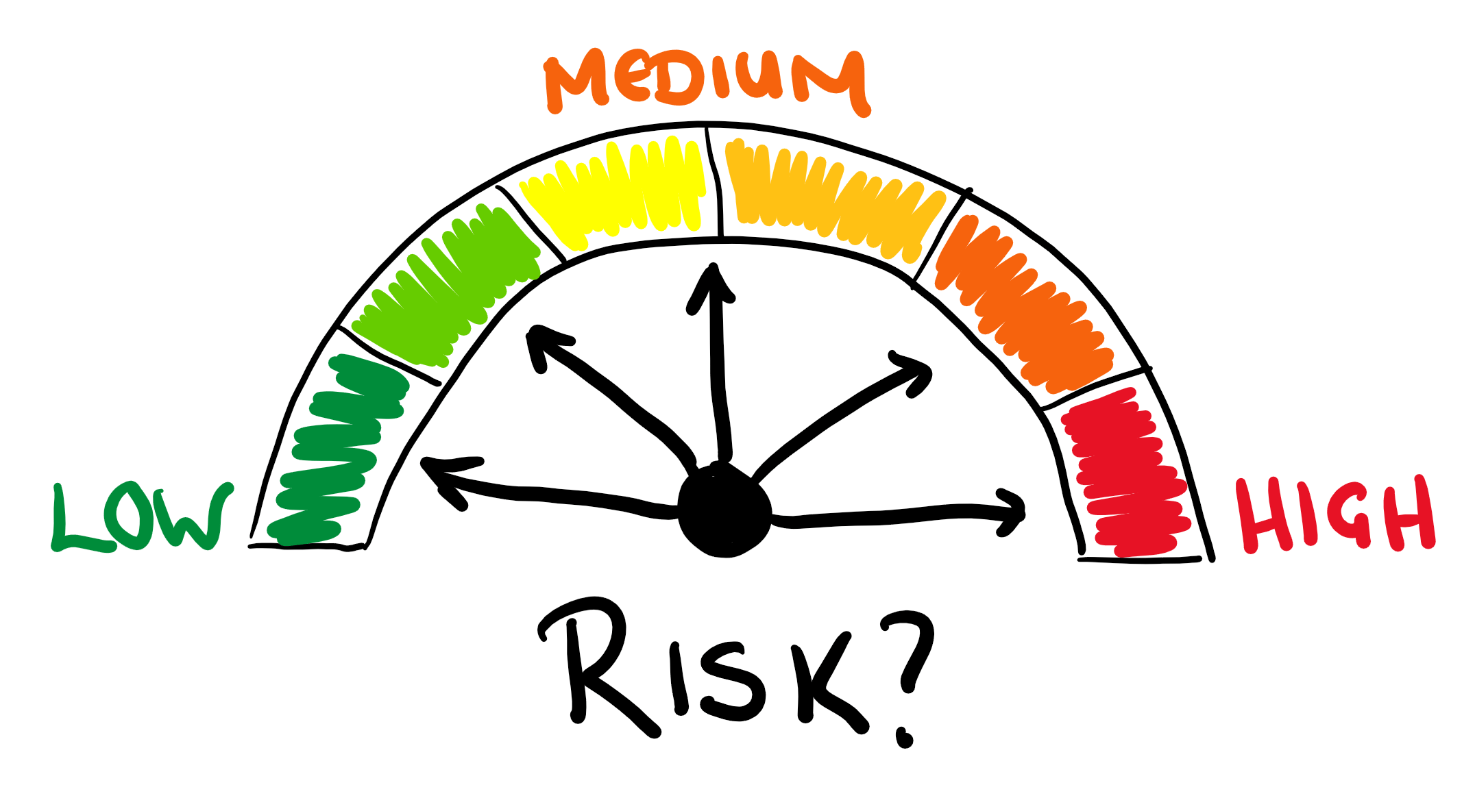
Innovation Risks and Dangers
Innovation Process Technological Failure
Financial Strain
Market Failure
Capacity lack of Implementation
Organizational risks
Unpredictable risks

Slide 13
CLASS ACTIVITY
CONTEXT
You and your team of software developers are working for a financial services company that aims to improve financial literacy among its clients. The company recognizes the challenges individuals face in managing their personal finances, including budgeting, saving, and investing wisely. Your team has been assigned to develop a new app that will empower users to take control of their financial well-being by providing them with personalized insights and tools.
In the context of designing this financial management app, how would you employ design thinking principles to ensure that the user experience is not only intuitive and effective but also addresses the emotional aspects associated with personal finance, fostering a positive and empowering relationship between users and their financial well-being?
INSTRUCTIONS
Divide the class into 3 groups
You have 15 mins to brainstorm.
Present your ideas using PowerPoint.
5 mins each for presentation

